Slide 1
Breast cancer –pathology
Dr.Gopika.R.S
Prof & Head ,Dept of Pathology
SKHMC

Slide 2
Carcinoma of breast
Cancer of the breast affects the left breast slightly more often than the right
Risk factors
Increased age,
family history of breast, ovary, or endometrial cancer,
>30 age at first pregnancy,
high socioeconomic status,
nulliparity,
early menarche, and late menopause

Slide 3
Risk factors
Genetic mutations-
BRCA 1 gene(DNA repair Gene) on chm: 17
BRCA 2 gene located on chromosome 13
p53 tumour suppressor gene

Slide 4
Histological Classification of Breast Cancer
Histogenesis –
duct, lobule (acini)
Histologic Characteristic –
adenocarecinoma, epidermoid CA, etc.
Gross Characteristic –
Scirrhous, colloid, medullary, papillary, tubular
Invasive Criteria –
In-situ,Infiltrating,

Slide 5
Types of carcinoma of the breast
Noninvasive
Ductal carcinoma in situ (DCIS)
Lobular carcinoma in situ (LCIS)
Invasive (infiltrating)
Invasive ductal carcinoma ("not otherwise specified")
Invasive lobular carcinoma
Medullary carcinoma
Colloid carcinoma (mucinous carcinoma)
Tubular carcinoma ,Papillary carcinoma
Other types

Slide 6
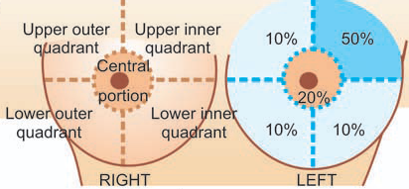
Carcinoma breast

Slide 7
Ductal Carcinoma in Situ
Seen as micro calcifications on mammogram
Confined to ductal cells.
No invasion of the underlying basement membrane.

Slide 8
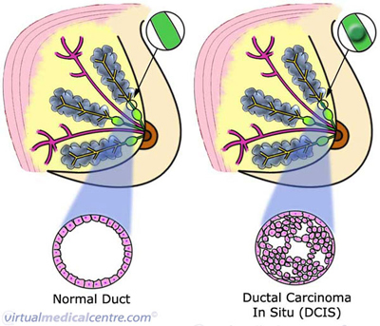

Slide 9
Lobular Carcinoma in Situ
Not detectable on mammography
Most commonly found incidentally

Slide 10
Paget’s Disease
Uncommon
Usually involves the nipple
associated with an underlying intraductal or invasive carcinoma.
About 30% of patients have axillary node metastasis at diagnosis.

Slide 11
Paget's disease
Seen as thickened, sometimes pigmented, eczematoid, erythematous weeping or crusted lesion with irregular borders
the lesion is limited to the nipple or extended to the areola, and in advanced cases -involve the surrounding skin.
The surface of the lesion is occasionally slightly infiltrated.
Histologically
vacuolated cells are seen in the epidermis of the nipple and result in an eczematous dermatitis of the nipple.

Slide 12
Invasive Breast Cancers
Favorable histologic types (85% 5-year survival rate)
Tubular carcinoma , grade 1 intra ductal, colloid or mucinous carcinoma, and papillary carcinoma
Less favorable types
Medullary , invasive lobular, and invasive ductal carcinoma

Slide 13
Favorable histologic types- Tubular carcinoma
rare, 2% of all breast cancers.
cancer cells look tube-like when examined under a microscope.
low grade and slow growing.
Generally diagnosed by mammography

Slide 14
Mucinous (colloid) carcinoma
is a rare type
less than 2% of all breast cancers.
begins in the duct of the breast
Bulky, mucinous tumor with characteristic microscopic features
elderly population

Slide 15
Papillary carcinoma
1-2% of breast cancers.
well-defined border and is made up of small, finger-like projections
seventh decade .
a slowly progressive disease

Slide 16
Less Favorable Histologic Types
Medullary carcinoma
4% of all invasive breast cancers
Soft, hemorrhagic bulky
Diagnosed microscopically - lymphocytic infiltration
Metastases to axillary nodes

Slide 17
Invasive ductal carcinoma
Carcinomas of "no special type" or "not otherwise specified" are synonyms for ductal carcinomas.
The majority (70% to 80%) of cancers fall into this group.

Slide 18
Microscopic
formation of solid nests, cords, gland-like structures and intraductal growth pattern of anaplastic tumour cells.
There is infiltration of densely collagenised stroma by tumour cells in a haphazard manner

Slide 19
Invasive lobular carcinoma
multi centric and bilateral
The cells invade individually into stroma
arranged in strands or chains
metastasize to CSF ,serosal surfaces, GIT, ovary and uterus, and bone marrow
these carcinomas express hormone receptors.

Slide 20
GROSS
varies from a well-defined scirrhous mass to a poorlydefined
area of induration usually remain undetected
by inspection as well as palpation

Slide 21
Microscopic
Tumour cells -round and
regular with very little pleomorphism and infrequent Mitoses
Arrangement - single file (Indian file) linear
arrangement of stromal infiltration by the tumour cells
Or arranged concentrically around ducts

Slide 22
Inflammatory carcinoma
1.5-3% of breast cancers
Characteristic - erythema, peau d’orange, and skin ridging with or without a palpable mass.
Disease progresses rapidly, and more than 75% of patients present with palpable axillary nodes.

Slide 23
Diagnosis
Mammogram
Fine-needle aspiration
Core-needle biopsy
Incisional biopsy
Excisional biopsy
Molecular – receptors - HER2 gene ,ER/PR

Slide 24
Staging
Primary Tumor
T1 = Tumor < 2 cm. in greatest dimension
T2 = Tumor > 2 cm. but < 5 cm.
T3 = Tumor > 5 cm. in greatest dimension
T4 = Tumor of any size with direct extension to chest
wall or skin
Regional Lymph Nodes
N0 = No palpable axillary nodes
N1 = Metastases to movable axillary nodes
N2 = Metastases to fixed, matted axillary nodes
Distant Metastases
M0 = No distant metastases
M1 = Distant metastases including ipsilateral
supraclavicular nodes

Slide 25
c/m
Asymptomatic
Lumps
Presenting symptom in 85% of patients
Pain
Must completely evaluate to rule out carcinoma
Metastatic disease
Axillary nodes
Distant organ symptoms, such as neurological

Slide 26
Refer
https://www.youtube.com/watch?v=TpUAsdZiDuM

